Slide 1
Liver Disease Stage Prediction
By
Sujani Chandrashekhar
&
Vandan Patel

Slide 2
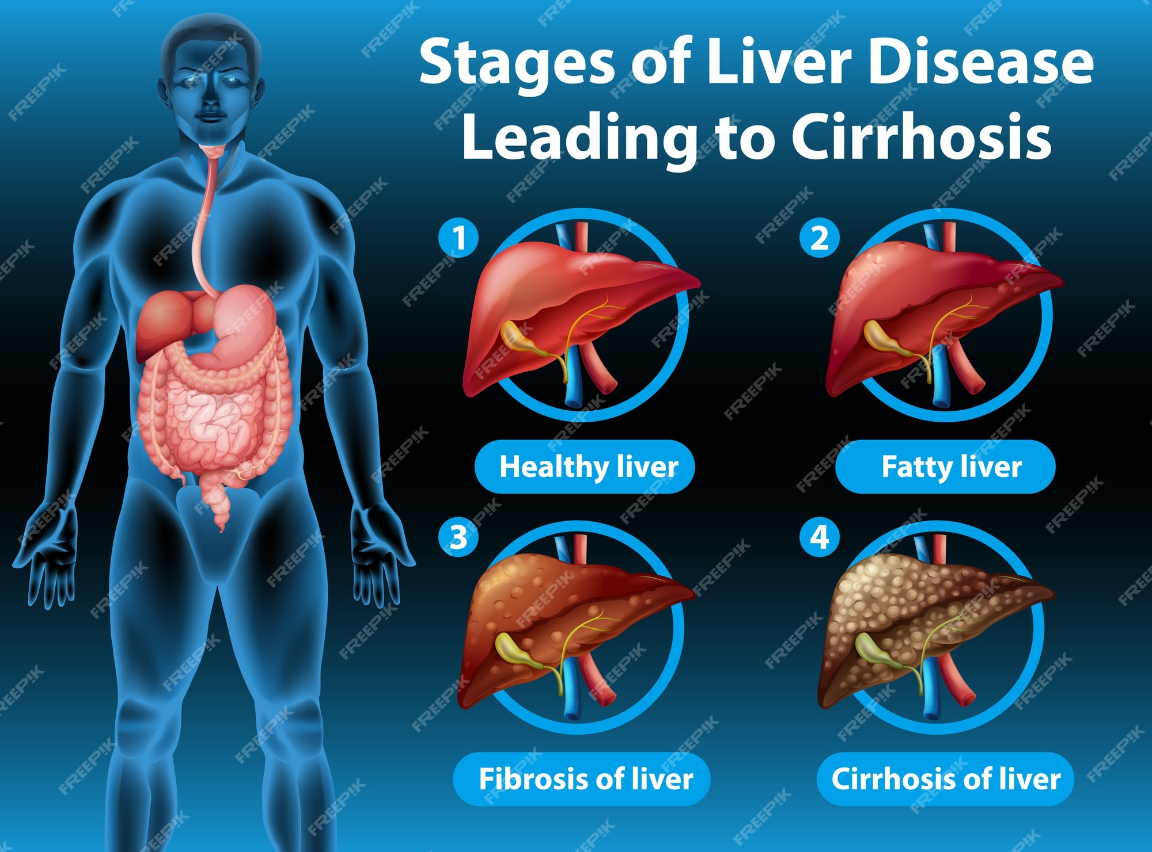
Description Of Our Data
Cirrhosis is a late stage of scarring (fibrosis) of the liver caused by many forms of liver diseases and conditions, such as hepatitis and chronic alcoholism.
In liver disease, there are mainly 3 stages which are as follows:
Stage 1 : Fatty Liver
Stage 2 : Liver Fibrosis
Stage 3 : Liver Cirrhosis
Our primary target is to predict the stage of the liver disease. The dataset consists of both numerical as well as categorical features.

Slide 3
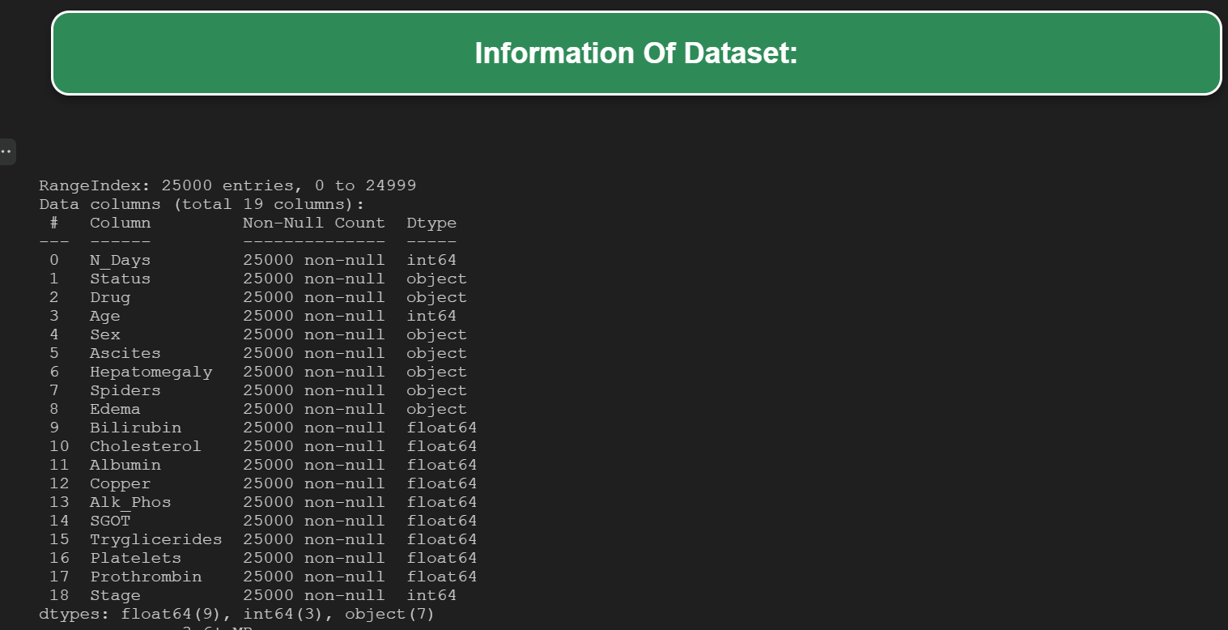
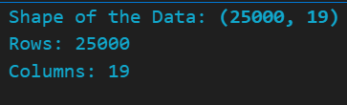
Data Overview
10) Bilirubin: serum bilirubin in [mg/dl]
11) Cholesterol: serum cholesterol in [mg/dl]
12) Albumin: albumin in [gm/dl]
13) Copper: urine copper in [ug/day]
14) Alk_Phos: alkaline phosphatase in [U/liter]
15) SGOT: SGOT in [U/ml]
16) Triglycerides: triglicerides in [mg/dl]
17) Platelets: platelets per cubic [ml/1000]
18) Prothrombin: prothrombin time in seconds [s]
19) Stage: stage of disease i.e (1, 2, 3)
1) N-Days: number of days between registration and the earlier of death, transplantation, or study analysis time.
2) Status: status of the patient C (censored), CL (censored due to liver tx), or D (death)
3) Drug: type of the drug. D-penicillamine or placebo
4) Age: age in [days]
5) Sex: M (male) or F (female)
6) Ascites: presence of ascites N (No) or Y (Yes)
7) Hepatomegaly: the presence of hepatomegaly N (No) or Y (Yes)
8) Spiders: the presence of spiders N (No) or Y (Yes)
9) Edema: the presence of edema N (no edema and no diuretic therapy for edema), S (edema present without diuretics, or edema resolved by diuretics), or Y (edema despite diuretic therapy)

Slide 4
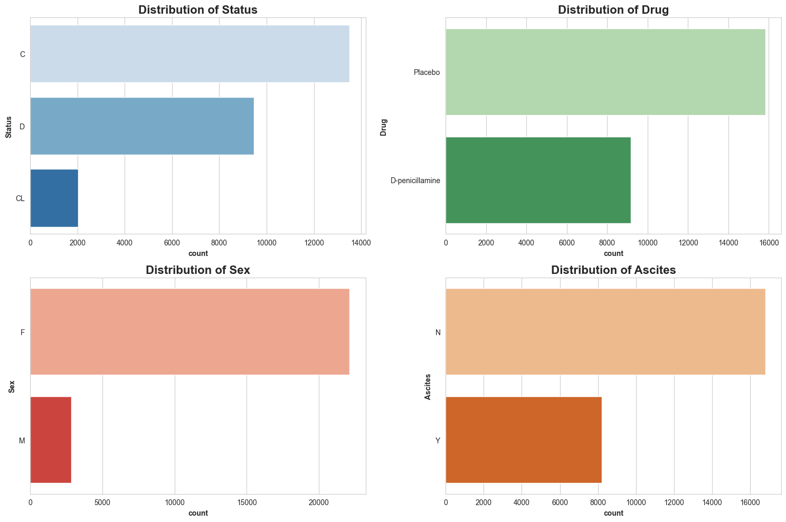
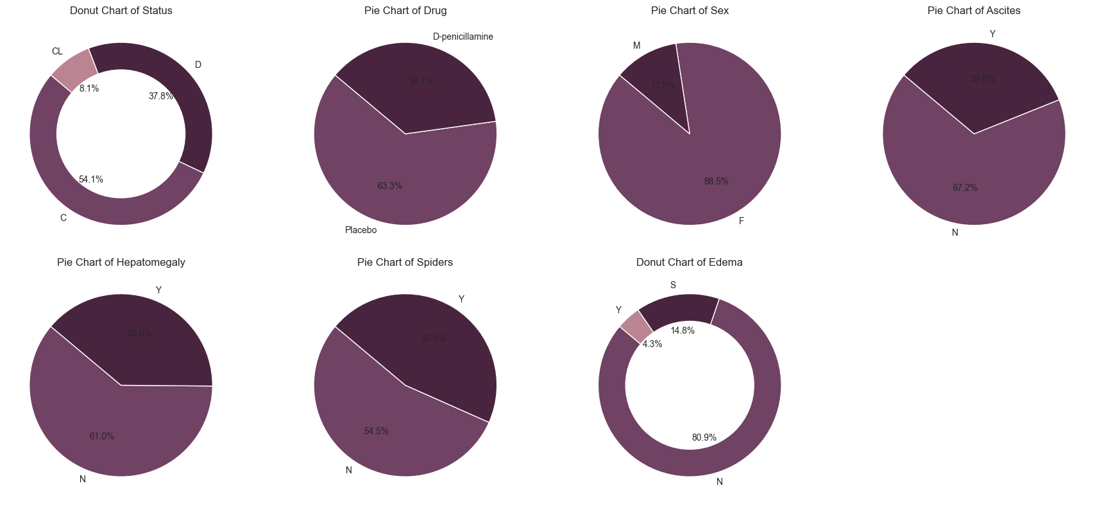
Visualization of Categorical Data

Slide 5
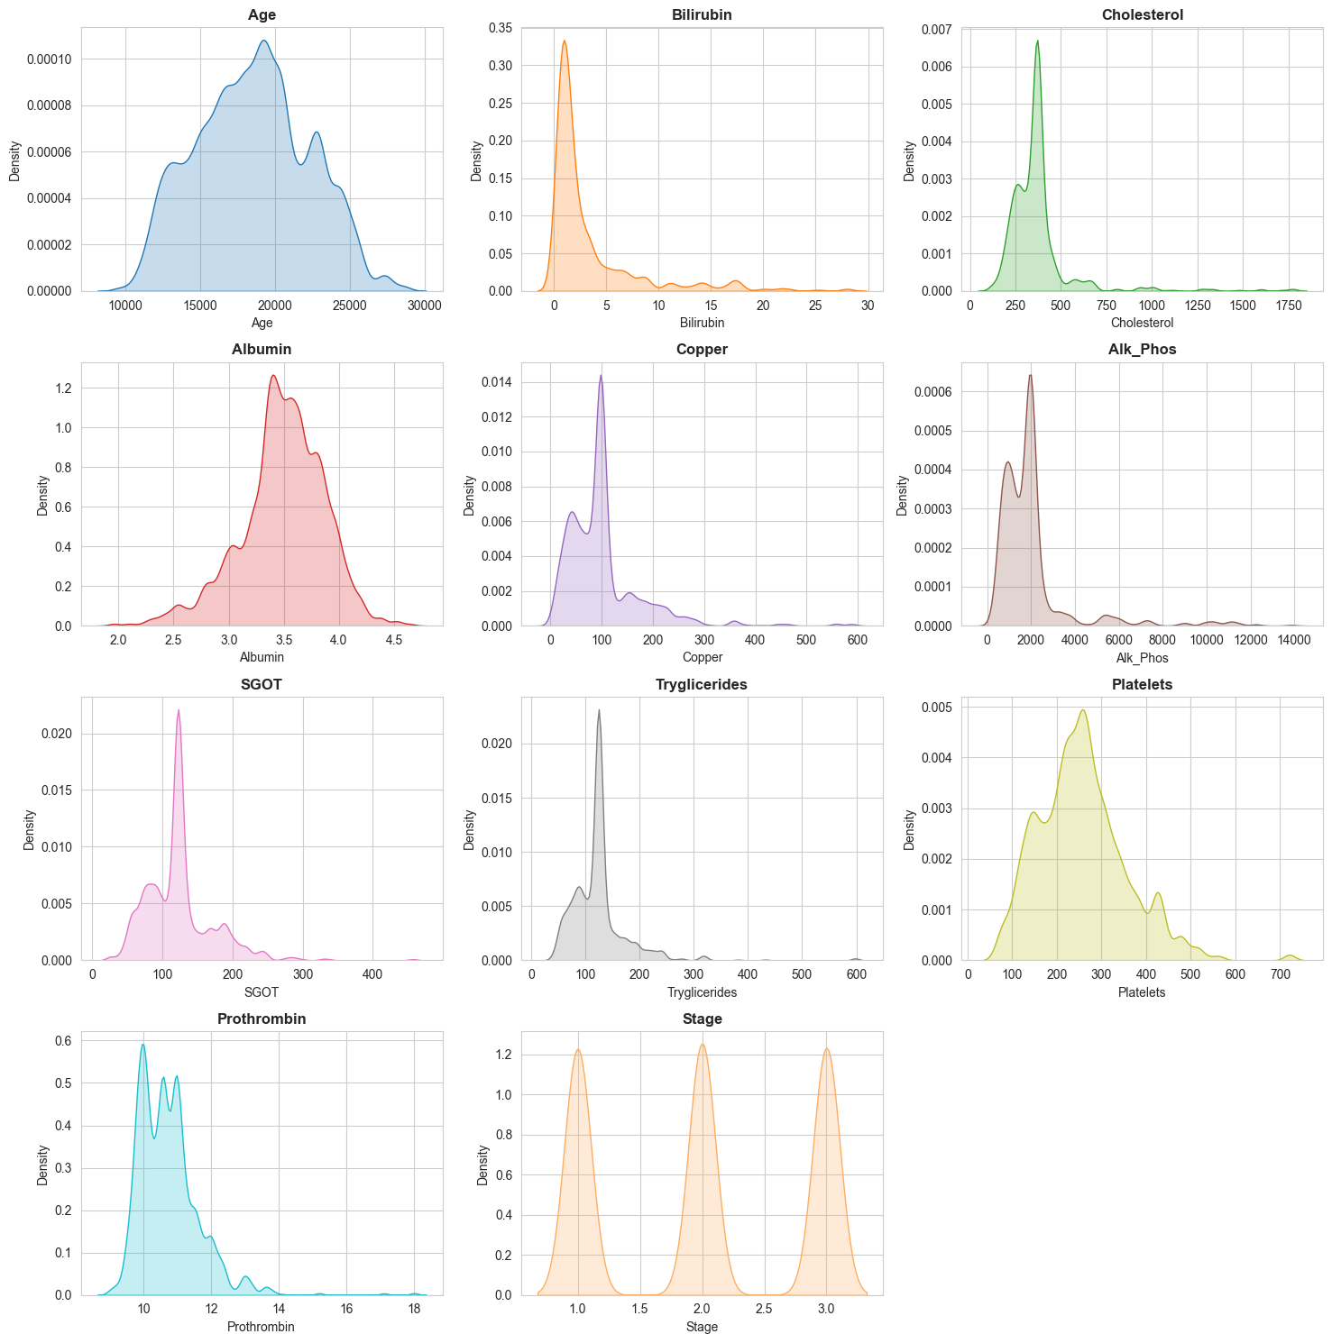
Analysis of Numerical Features
The graphs represent the Kernel Density Estimation (KDE) plots of key numerical features in the liver cirrhosis dataset.
Density here represents the probability density function of each feature, allowing us to understand the distribution of values and identify patterns such as skewness and outliers.
These visualizations help in identifying common ranges for each feature, spotting potential outliers, and understanding their overall distribution shape. For example, features like Bilirubin and Copper show right-skewed distributions, indicating a large proportion of lower values and fewer higher values.

Slide 6
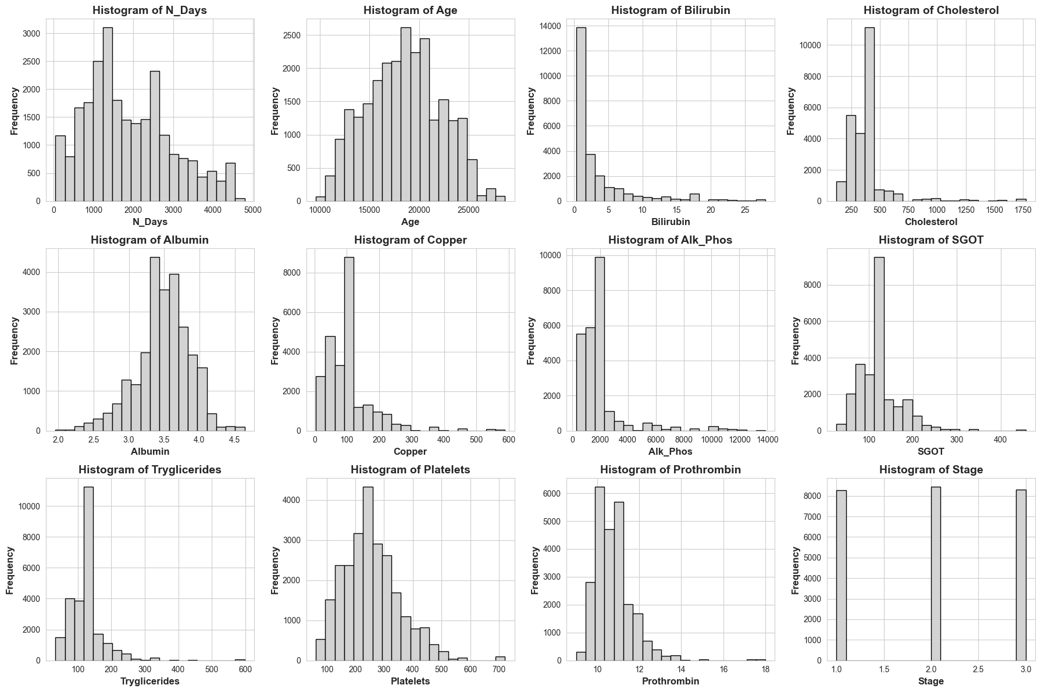
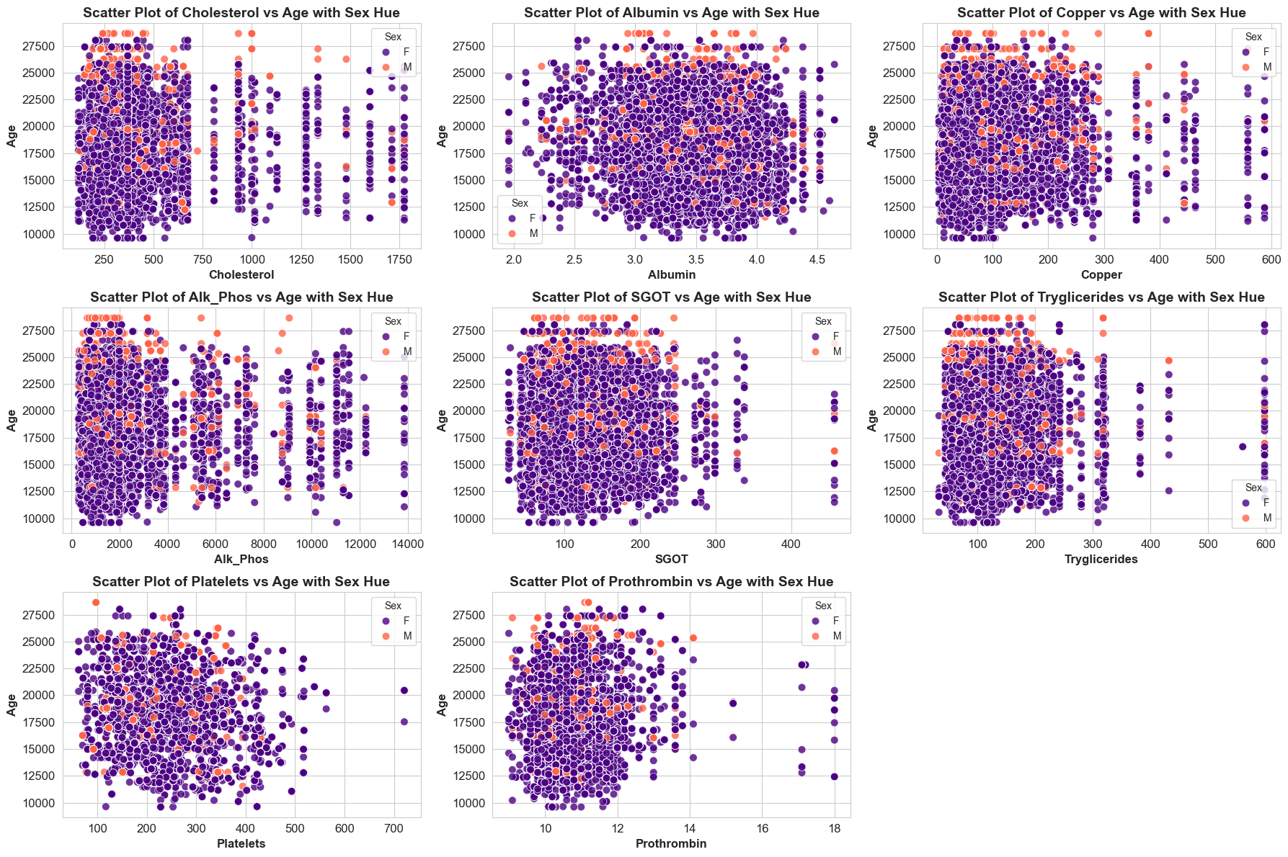

Slide 7
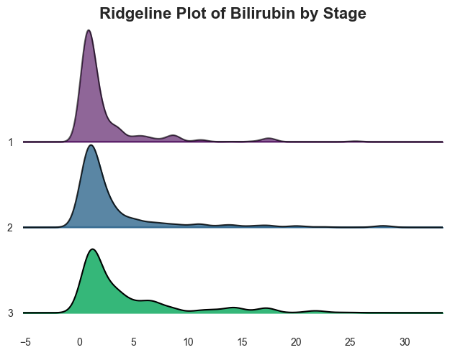
Ridgeline Plot
The Ridgeline plot reveals how Bilirubin levels change as liver cirrhosis progresses through different stages. It shows the density distribution of Bilirubin for each stage, making it easier to compare how this critical biomarker varies across stages.
As we move from early stages (e.g., Stage 1) to advanced stages (e.g., Stage 3), the density curves of Bilirubin may shift, indicating increasing levels of Bilirubin with disease progression. This suggests that Bilirubin might be a potential indicator of cirrhosis severity.
The plot also helps to spot any outliers or unusual trends in Bilirubin values for specific stages. For example, a wide distribution or unusually high values in a particular stage may warrant further investigation.

Slide 8
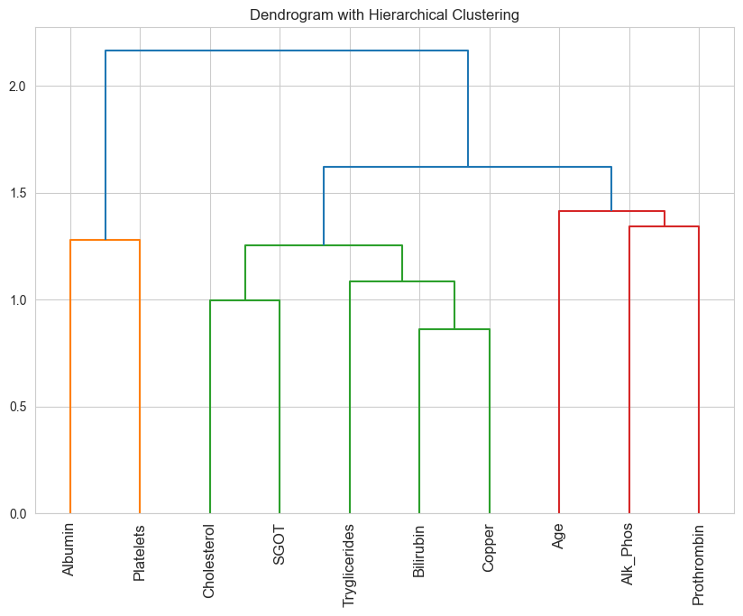
Hierarchical Clustering for Relationship
The dendrogram shows how features are related, grouping similar ones together based on correlation.
Highly correlated features are clustered, suggesting potential candidates for removal to simplify the model without losing important information.
Helps uncover patterns among features, like how age and certain biochemical markers (e.g., Alk_Phos and Prothrombin) cluster together.
Guides dimensionality reduction by highlighting highly correlated features, helping simplify the model while retaining key information.

Slide 9
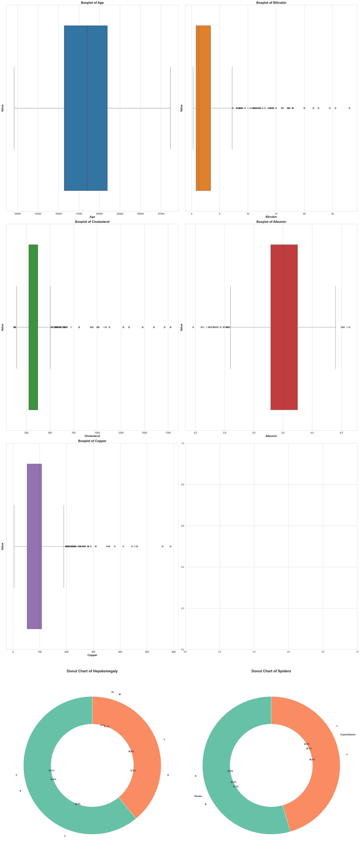
Outlier Detections
The boxplots clearly indicate the presence of outliers, particularly in features like Bilirubin, Cholesterol, and Copper, suggesting extreme values in these data columns.
Features like Albumin show minimal outliers, while others like Copper have several, highlighting differences in data distribution across various attributes.
The detection of these outliers is crucial for data preprocessing and model building, ensuring that anomalies are either appropriately treated or accounted for to improve model performance.

Slide 10
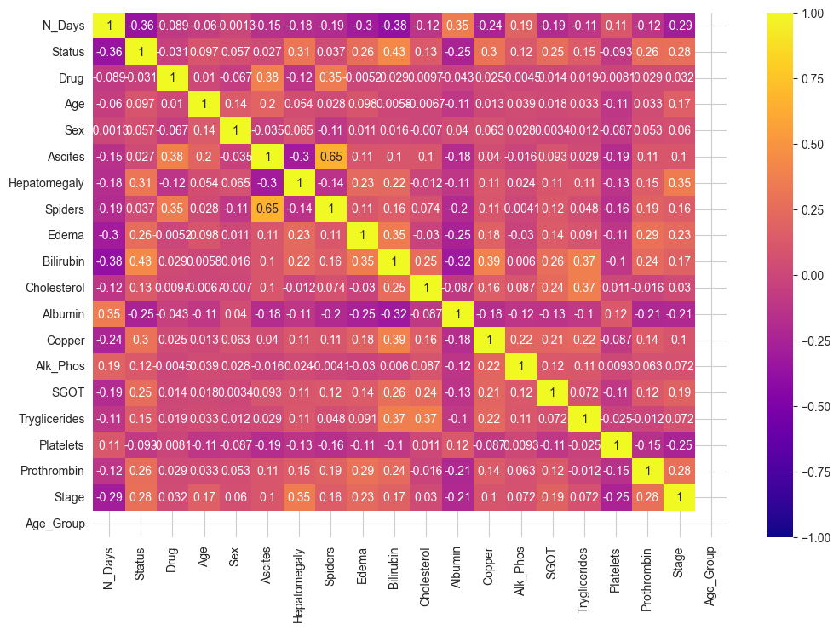
Correlation Matrix
The heatmap displays the correlations between numerical features in the dataset. Strong correlations are highlighted in brighter colors, while weaker correlations are in darker shades.
Features like Cholesterol and Copper show a high correlation (closer to 1), suggesting a strong relationship between these variables. Ascites and Hepatomegaly also exhibit a noticeable correlation, which might indicate a co-occurrence pattern.
Some features show a negative correlation, such as N-Days and Bilirubin, suggesting that as one increases, the other tends to decrease.
Understanding correlations helps in feature selection and reducing multicollinearity issues, leading to a more interpretable and efficient predictive model. Features that are highly correlated may provide redundant information, which is useful for dimensionality reduction techniques.

Slide 11
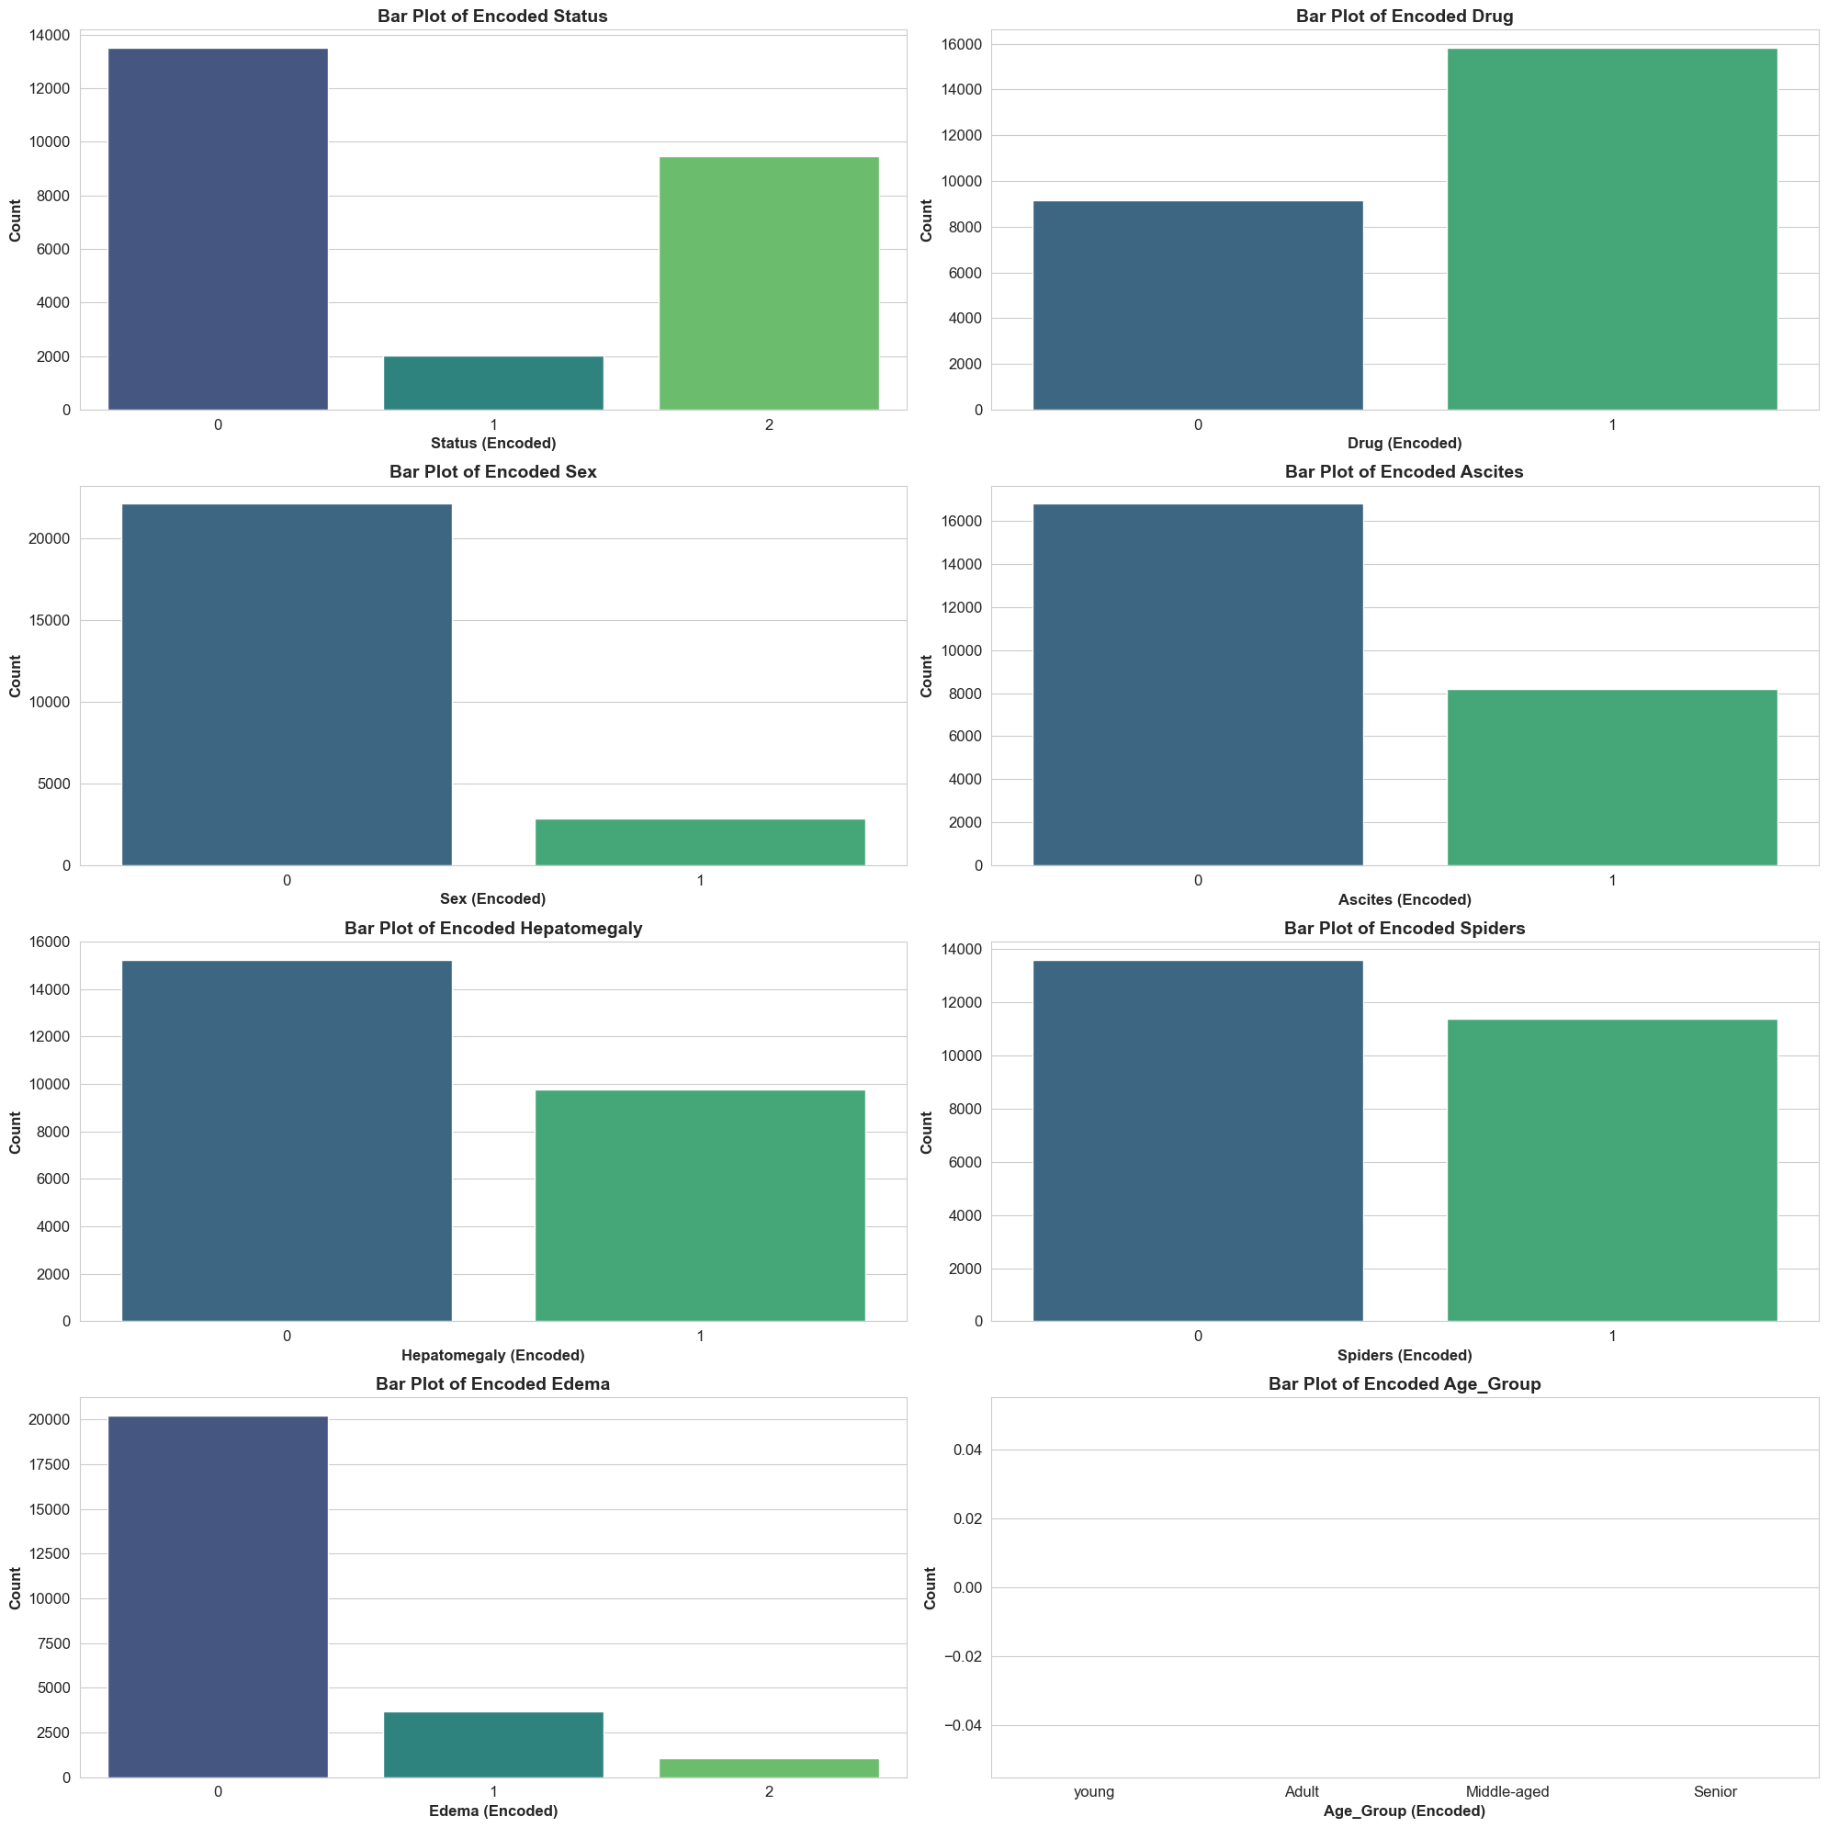
Label Encoding
In the liver cirrhosis dataset, several features are categorical but with a manageable number of categories. Label Encoding efficiently represents these categories as numerical values, which reduces the feature space and avoids memory and computational overhead.
Most machine learning models, especially tree-based models like Decision Trees, Random Forests, and Cat-Boost, can handle numerical labels directly without assuming any ordinal relationships. This makes Label Encoding a suitable choice as it doesn't introduce unnecessary complexity.
One-Hot Encoding would significantly increase the number of features, especially if multiple categorical variables have several unique values. This increase can lead to a sparse dataset, which might negatively impact model training efficiency and performance. Label Encoding keeps the number of features low and manageable.

Slide 12
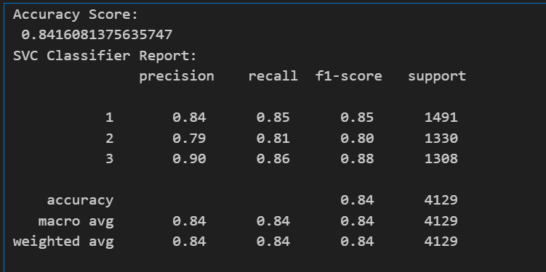
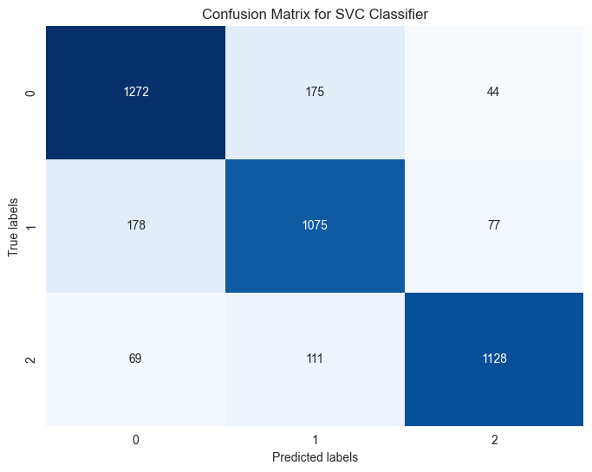
Support Vector Classifier
SVC is well-suited for classification problems, particularly for complex datasets where the decision boundary between classes is not linear.
It works efficiently for multi-class classification, as demonstrated in our project involving multiple stages of liver cirrhosis. SVC is effective in handling high-dimensional data, and our dataset's features benefit from this strength.
The accuracy score for the SVC model is 84.16%, which shows a reliable level of performance for this classification problem. The classification report provides metrics such as precision, recall, and f1-score for each of the three stages. The weighted average precision and f1-score are both 0.84, suggesting that the model performs consistently across all classes.
SVC performed well in capturing the complex relationships in the liver cirrhosis dataset.

Slide 13
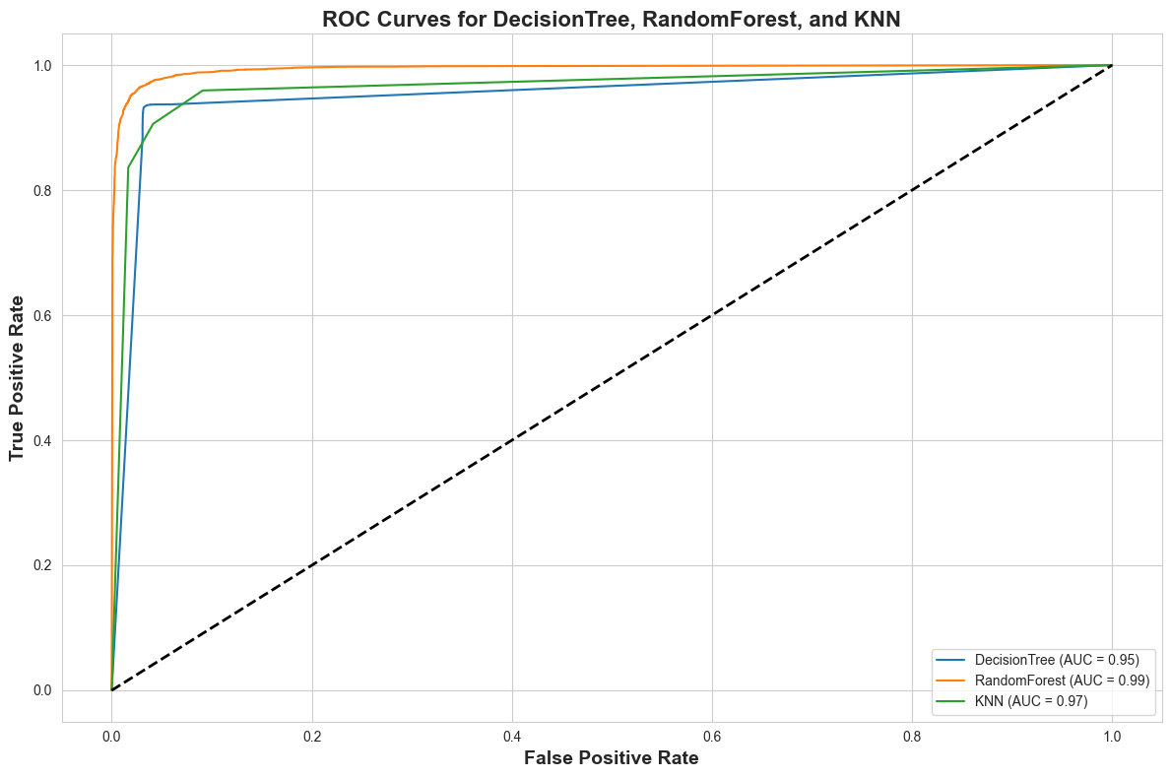
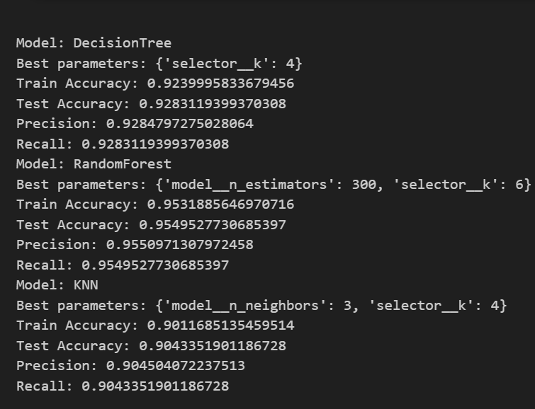
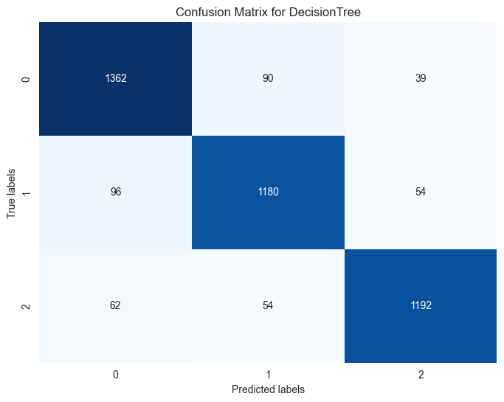
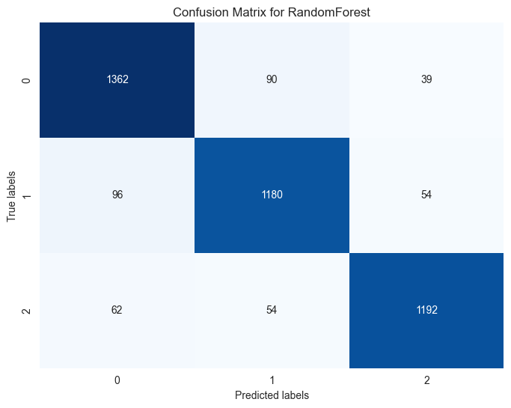
Exploring Other Models
Decision Tree, Random Forest, and KNN were also considered, and their evaluation metrics were compared.
Random Forest performed best among the models with a test accuracy of 95.49% and the highest ROC-AUC score (99%). KNN and Decision Tree also performed well, but their performance slightly lagged behind Random Forest.
SVC provides a good balance between bias and variance, which is useful for handling complex relationships in data. Despite lower accuracy compared to Random Forest, SVC's ability to handle non-linear decision boundaries and avoid overfitting led to its selection.

Slide 14
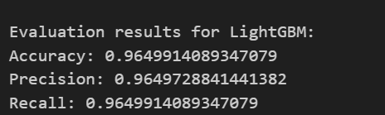
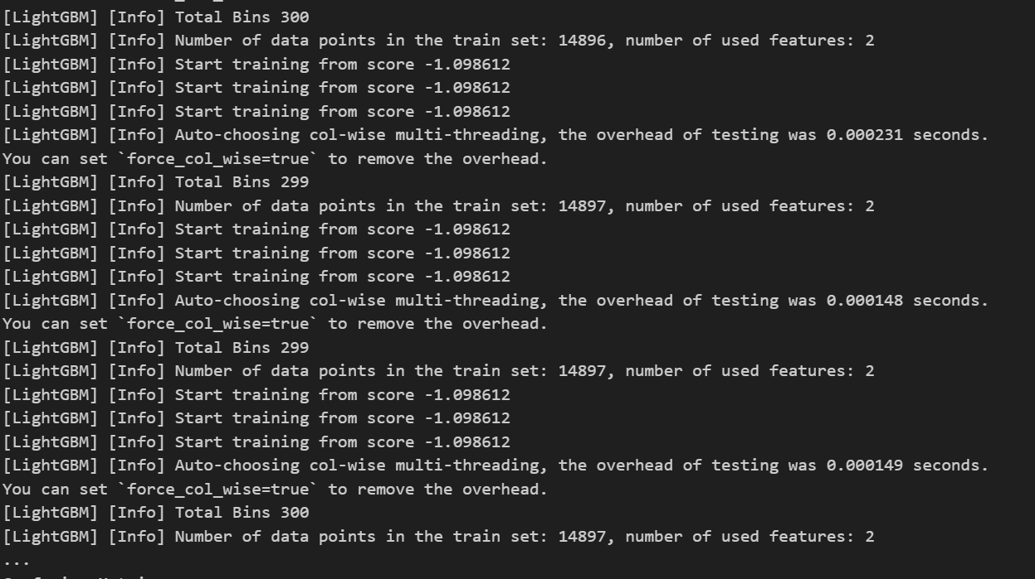
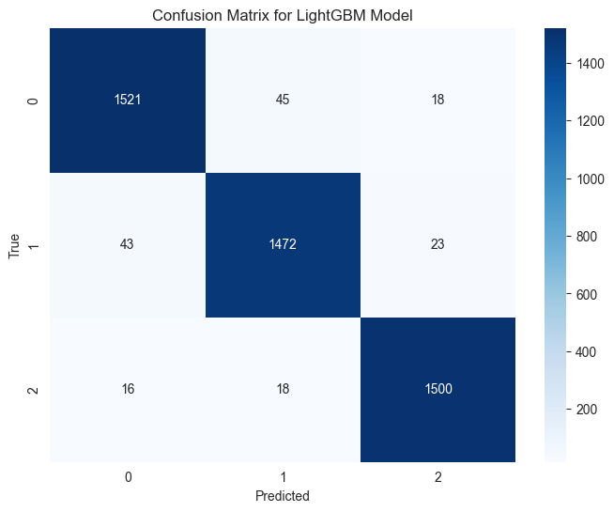
Light GBM Model
LightGBM (Light Gradient Boosting Machine) is an efficient, distributed, high-performance gradient boosting framework that is based on decision tree algorithms. It is designed to be highly scalable and is often used for large datasets due to its speed and accuracy.
LightGBM supports automatic handling of imbalanced classes, which made it suitable for my dataset, which had a varied distribution across different classes.
The training process was extremely fast, even with the large number of features in my dataset. LightGBM achieved 96.5% accuracy, which was the highest among many of the algorithms used.
LightGBM provides feature importance, which helped me understand which features were contributing the most to predictions. They were Age, Bilirubin, Albumin and soo on……

Slide 15
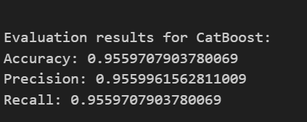

Catboost Model
CatBoost naturally supports categorical features, which simplified data preprocessing for my project. The model’s class weighting feature helped deal with imbalance issues, leading to improved classification results.
CatBoost provided 95.6% accuracy, and showed consistent performance with minimal overfitting.
With precision and recall scores both around 95.6%, CatBoost gave a well-rounded performance across different classes.
CatBoost (Categorical Boosting) is a machine learning algorithm that is particularly effective for categorical data. It handles categorical features automatically without the need for preprocessing like one-hot encoding, making it very user-friendly.

Slide 16
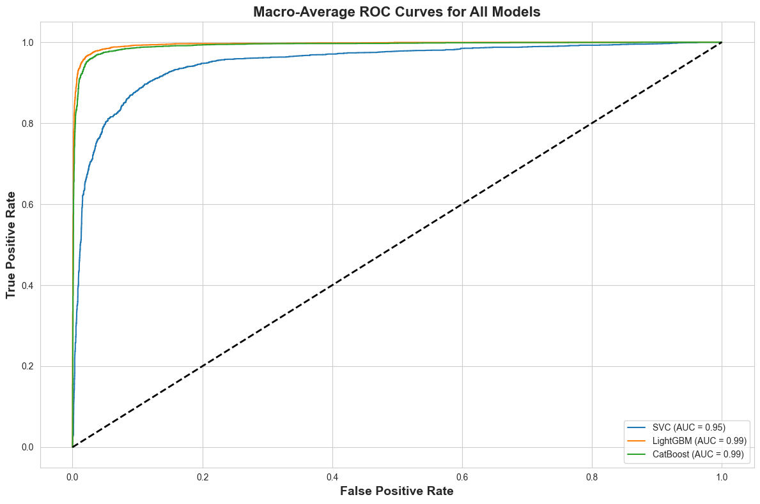
Conclusion
Objective Achieved: Successfully implemented and evaluated multiple machine learning models, optimizing their performance for better accuracy and reliability.
Best Model Performance: LightGBM and CatBoost models outperformed others with an accuracy of 96.5%. Stack ensembling further enhanced the robustness of predictions.
Effective Feature Selection: Using Select-K-Best for feature selection improved interpretability and reduced overfitting.

Slide 17
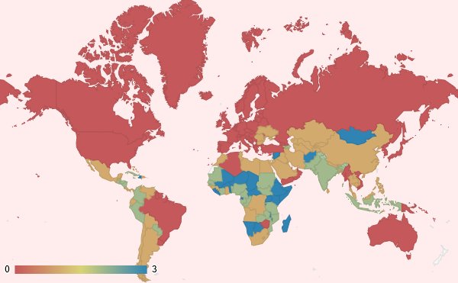
Future Goals
Advanced Diagnostic Support
Leverage the predictive capabilities of LightGBM and CatBoost models to assist healthcare professionals in diagnosing conditions more accurately, ultimately supporting faster decision-making in clinical settings.
Integration into Medical Systems
Integrate these models into Electronic Health Record (EHR) systems to provide real-time risk assessments, supporting doctors in identifying high-risk patients and optimizing intervention strategies.
Personalized Treatment Plans
Use model insights to predict patient-specific outcomes and risk factors, thereby facilitating the creation of personalized treatment plans tailored to the unique characteristics of each patient.

Slide 18
Thank You

